Slide 1
Cell And Tissue Engineering – Course Project
Neural-Spinal Scaffold: a Spinal Cord Injury Regeneration Platform
And OPC1, Oligodendrocyte Progenitor Cell Therapy
Yves Greatti
December 3, 2022

Slide 2
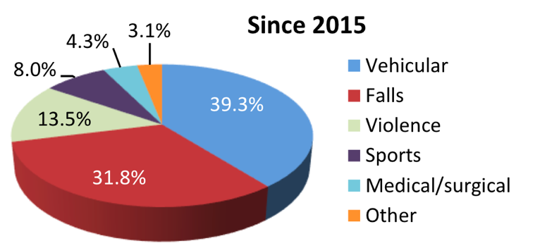
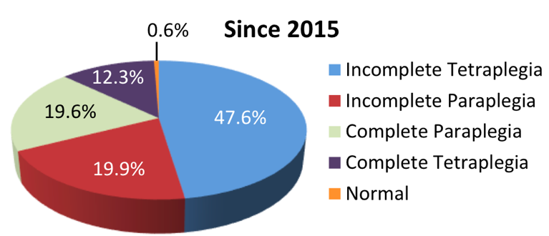
Spinal Cord Injury (SCI) Hard Facts
Incidence
Since 2015, in the U.S, about 18,000 new cases each year
Prevalence
Between 250,000 and 368,000 persons
Causes | Neurological Level and Extent of Lesion
Notes:
Traumatic spinal cord injury (SCI) is a debilitating neurological condition with severe socioeconomic impact on the health care system.
The age distribution is bimodal with a first peak involving young adults and a second peak for adults over the age of 60.
SCIs are mostly contusion (49%), or lacerations (21%).

Slide 3
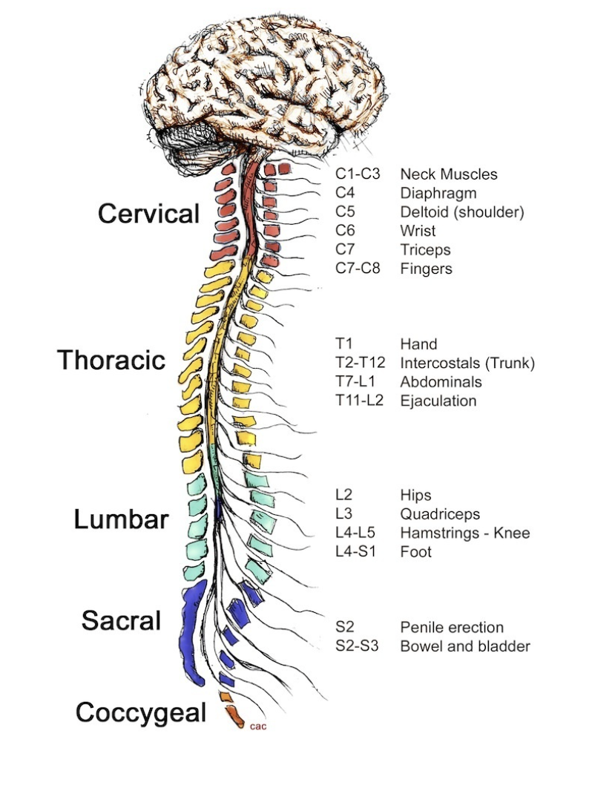
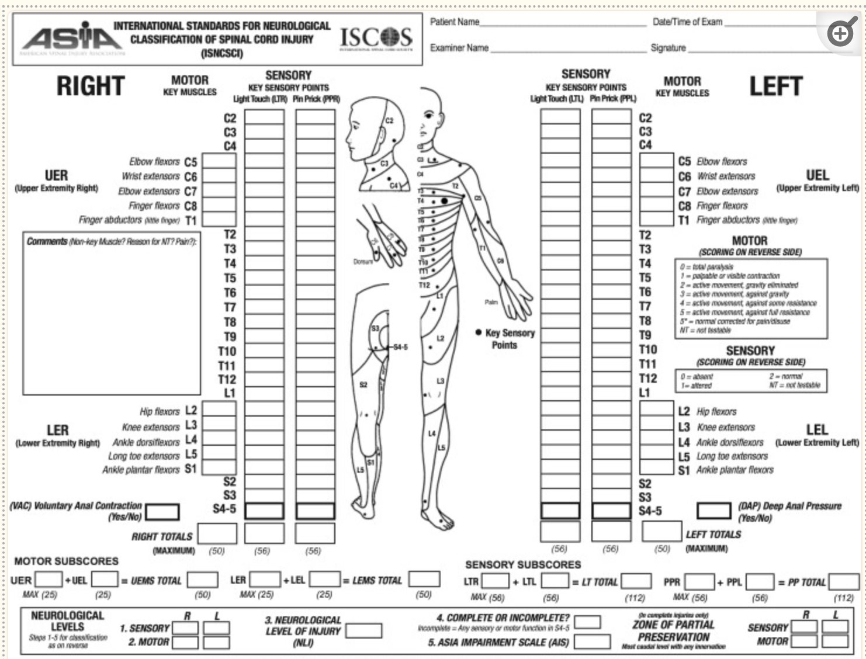
ASIA* Impairment Scale (AIS) Score
*American Spinal Injury Association International Standards for Neurological Classification of Spinal Cord Injury
Notes:
The American Spinal Injury Association Impairment Scale is a standardized neurological examination used by the rehabilitation team to assess the sensory and motor levels which were affected by the spinal cord injury. T
ASIA A: Complete, no motor or sensory function is preserved below the level of the injury, including the sacral segments S4 – S5
ASIA B: Incomplete Sensory, but not motor function is preserved below the neurological level of injury, and includes the sacral segments S4 – S5
ASIA C: Incomplete, motor function is preserved below the neurological level of injury, but more than half of the key muscles below the level have a muscle grade less than 3 (i.e. unable to move against gravity)

Slide 4
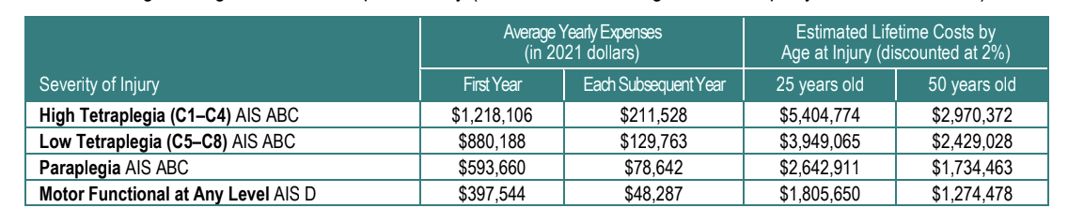
SCI Burden and Critical Needs
Cost*
$2,601 daily average cost for patients with AIS-A,-B, or –C
75% of patients are unemployed 10 years post injury
Lifetime cost: from 1 to 5 Million
Re-Hospitalization*
Since 2015, about 30% of persons with SCI are re-hospitalized one or more times following injury
Leading causes: disease of the skin, respiratory, digestive, circulatory, and musculoskeletal diseases
*National SCI statistical Center, 2019 Data Sheet.

Slide 5
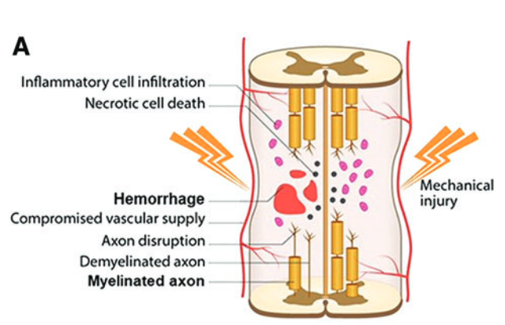
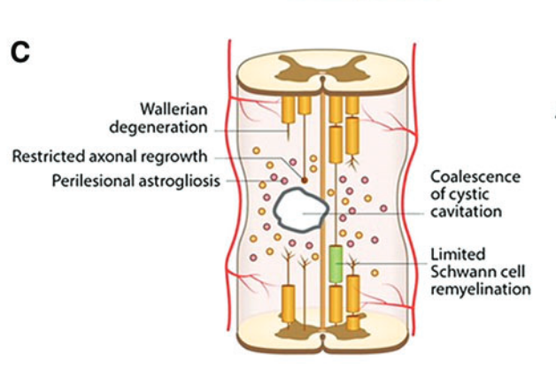
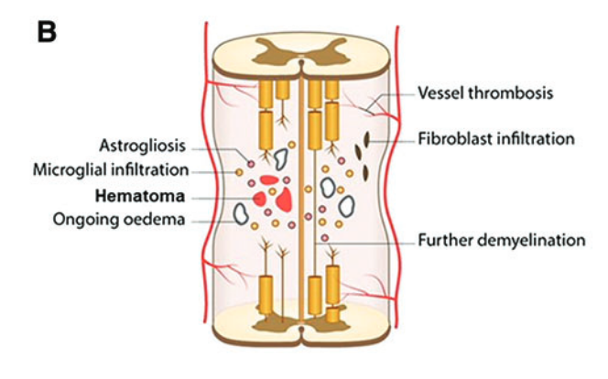
The Pathology of Human Spinal Cord Injury*
Acute Phase
Sub-acute Phase
Chronic Phase
Hours to 1 to 2 days
Days to weeks
Weeks to Months
*Norenberg, Michael D., et al. “The Pathology of Human Spinal Cord Injury: Defining the Problems.”
Notes:
Acute phase:
Edema, hemorrhage, and inflammation.
Pressure-induced ischemia caused by diminished blood flow to the injured region.
Neuronal apoptosis
Demyelination and oligodendroglial changes.
Sub-acute phase:
Microglial activation which is transformed into macrophages
Astrocyte hypertrophy
Vascular response
Chronic phase:
Wallerian degeneration
Development of mesenchymal scar and cyst/cavities
Schwannosis

Slide 6
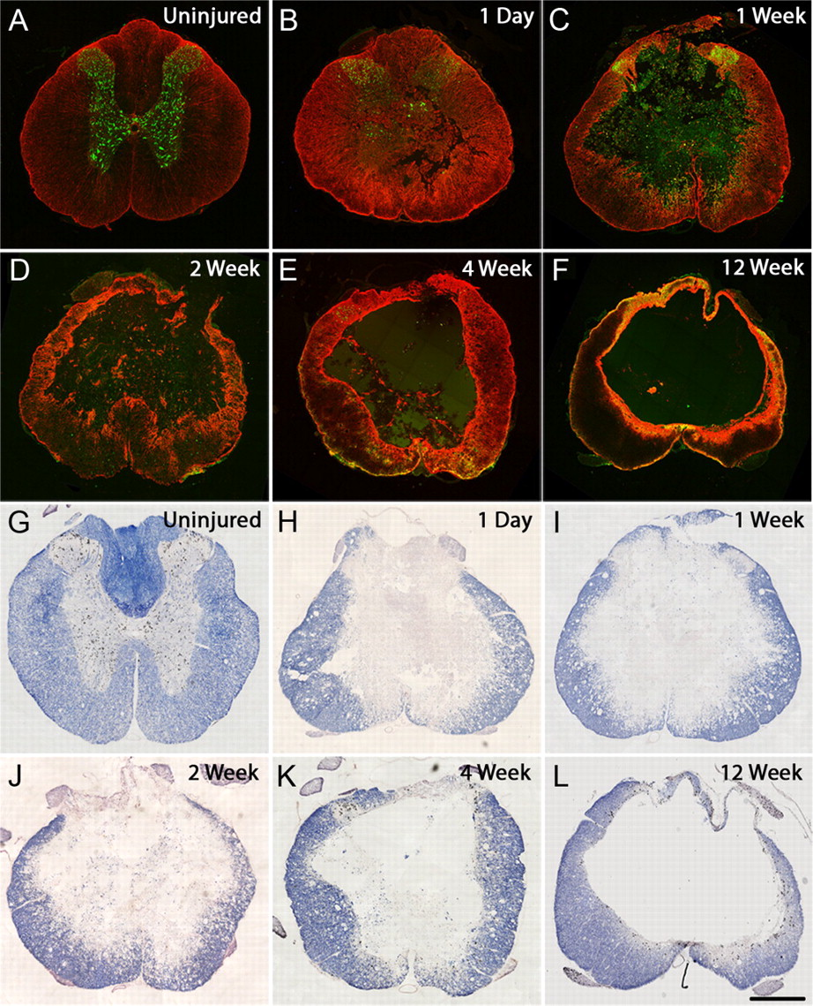
Anatomical Changes from Acute to Chronic Stages*
Compared to uninjured spinal cord, following injury:
Progressive cell loss
Reactive gliosis, and cavitation
Decrease of white and gray matter
*Nicholas D. James et al. “Conduction Failure following Spinal Cord Injury: Functional and Anatomical Changes from Acute to Chronic Stages”
Notes:
Aprogressive cell loss, reactive gliosis, and cavitation.
GFAP and NeuN immunohistochemistry (A–F) and
eriochrome cyanine staining (G–L) in transverse sections of the spinal cord through epicenter of the injury demonstrate the pathological changes taking place from acute to chronic time points after injury (1 d to 12 weeks)
can be compared with uninjured spinal cord (A, G). GFAP (astrocytes; red) and NeuN (neuronal cell bodies; green) costaining illustrates the progressive destruction of the gray matter and neuronal cell loss that occurs following injury as well as the pronounced increase in reactive gliosis acutely following injury (B), which at later stages becomes more localized to the borders of the cavity,
forming a dense glial scar (C–F). Staining with eriochrome cyanine (to demarcate gray and white matter areas) highlights the initial phase of mass necrosis in the spinal parenchyma at early stages
(H–J) followed by clearance of the debris, resulting in large central cavities surrounded by a spared rim of white matter at chronic postinjury time points (K, L). Scale bar, 500 μm.

Slide 7
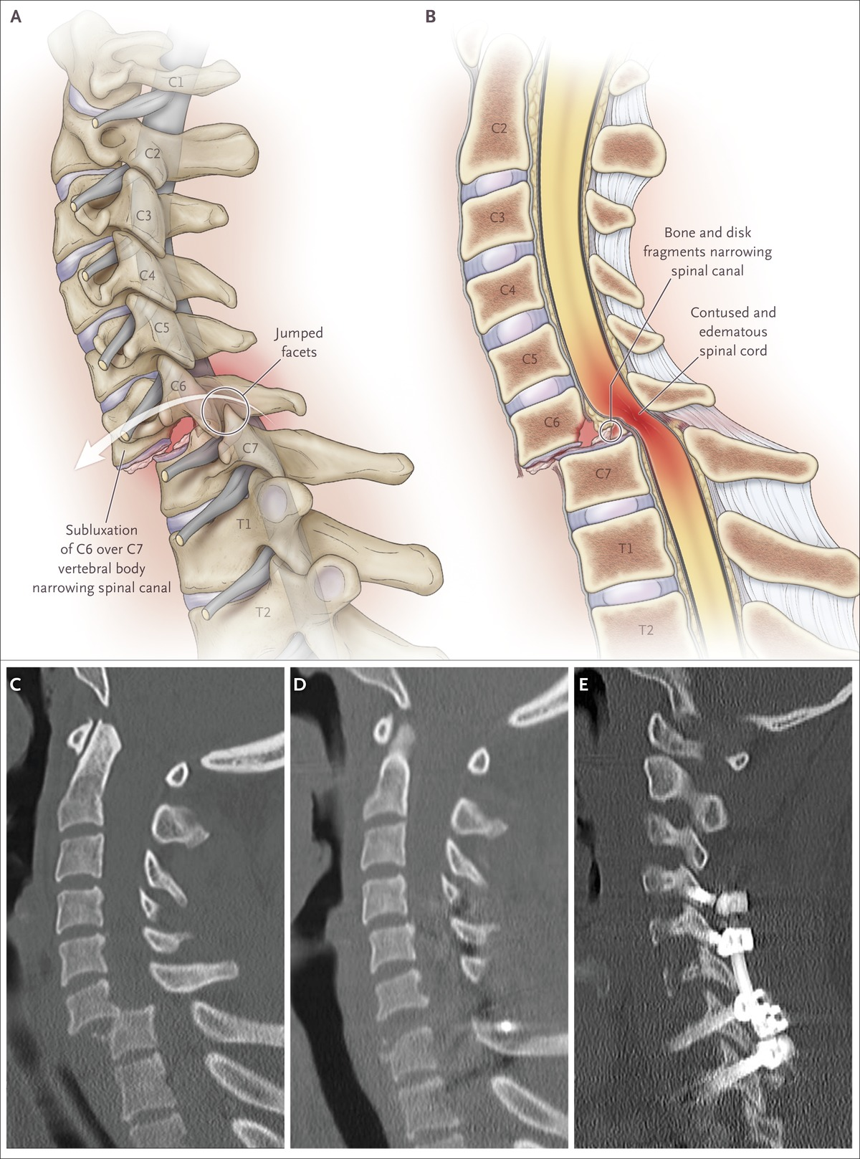
Recovery of Neural Functions in SCI is rare
No globally accepted standard treatment
Traditional treatment consist in:
Stabilization of the vertebral column
Methods to reduce inflammation:
hypothermia, cerebrospinal fluid drainage, anti-inflammatory drugs, electrical field stimulation
- Physical rehabilitation
Goals of modern regenerative therapies
- Minimally invasive
- Targeting the secondary or chronic stages of injury
Gains in extremities functions (arms and fingers) to improve independence and quality of life
Notes:
Hypertension induced by aortic cross-clamping results in an increase of cerebrospinal fluid pressure (CSFP),
lowering spinal cord perfusion pressure (SCPP) and diminishing blood supply to the spinal cord.
In addition, veins collapse when CSFP within spinal cord tissue becomes higher than venous pressure.
Drainage of the CSF (CSFD) reduces CSFP, improving SCPP.

Slide 8
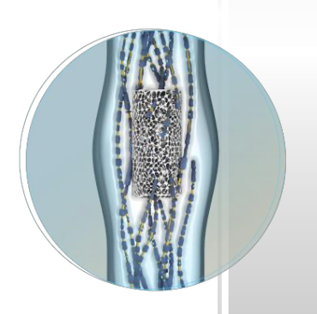
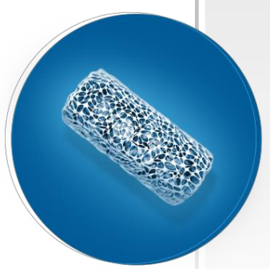
Neural-Spinal Scaffold
PLGA-PLL biopolymer
Biocompatible and bioresorbable
Consists in inner and outer ”mini” tubes
PLGA is the biodegradable scaffold along which cells can grow
- Poly-L-Lysine promotes cellular adhesion
Scaffold is implanted lengthwise at the injury site using an internal decompression procedure

Slide 9
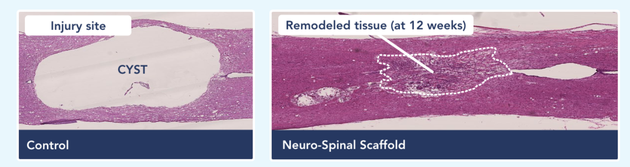
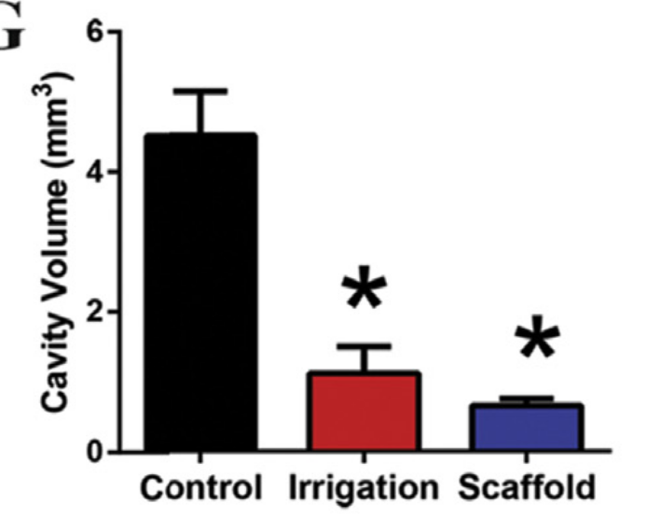
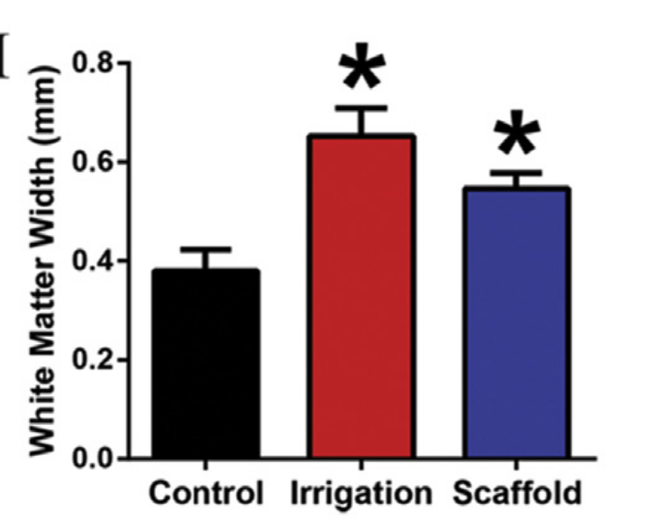
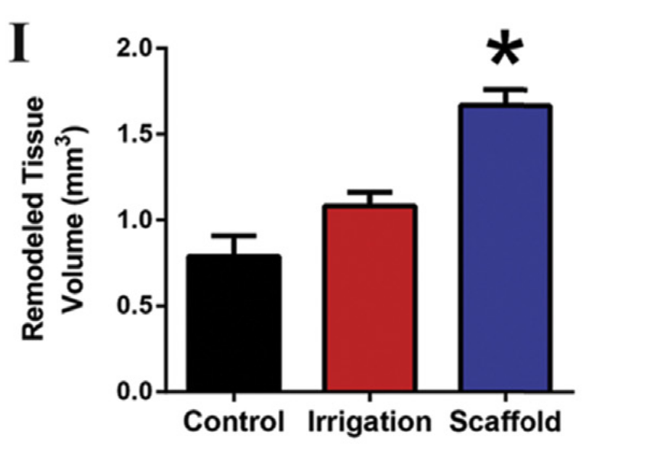
NS Scaffold reduced cystic cavitation and promoted new tissue formation
Rat model of acute SCI (at 12 weeks):
86% in cavity volume
44% preserved tissue
111% increase in new tissue volume
Cyst Reduction
White Matter Sparing
Remodeled Tissue
*p < 0.05

Slide 10
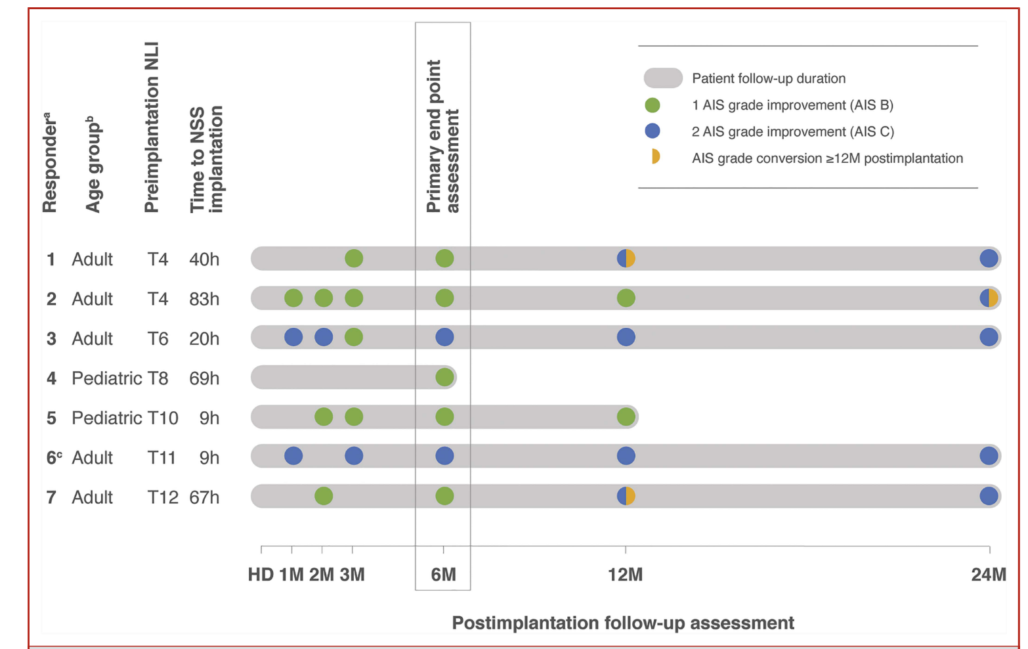
INSPIRE Clinical Trial Results
Out of 16, 7 (44%) patient AIS scores improved

Slide 11
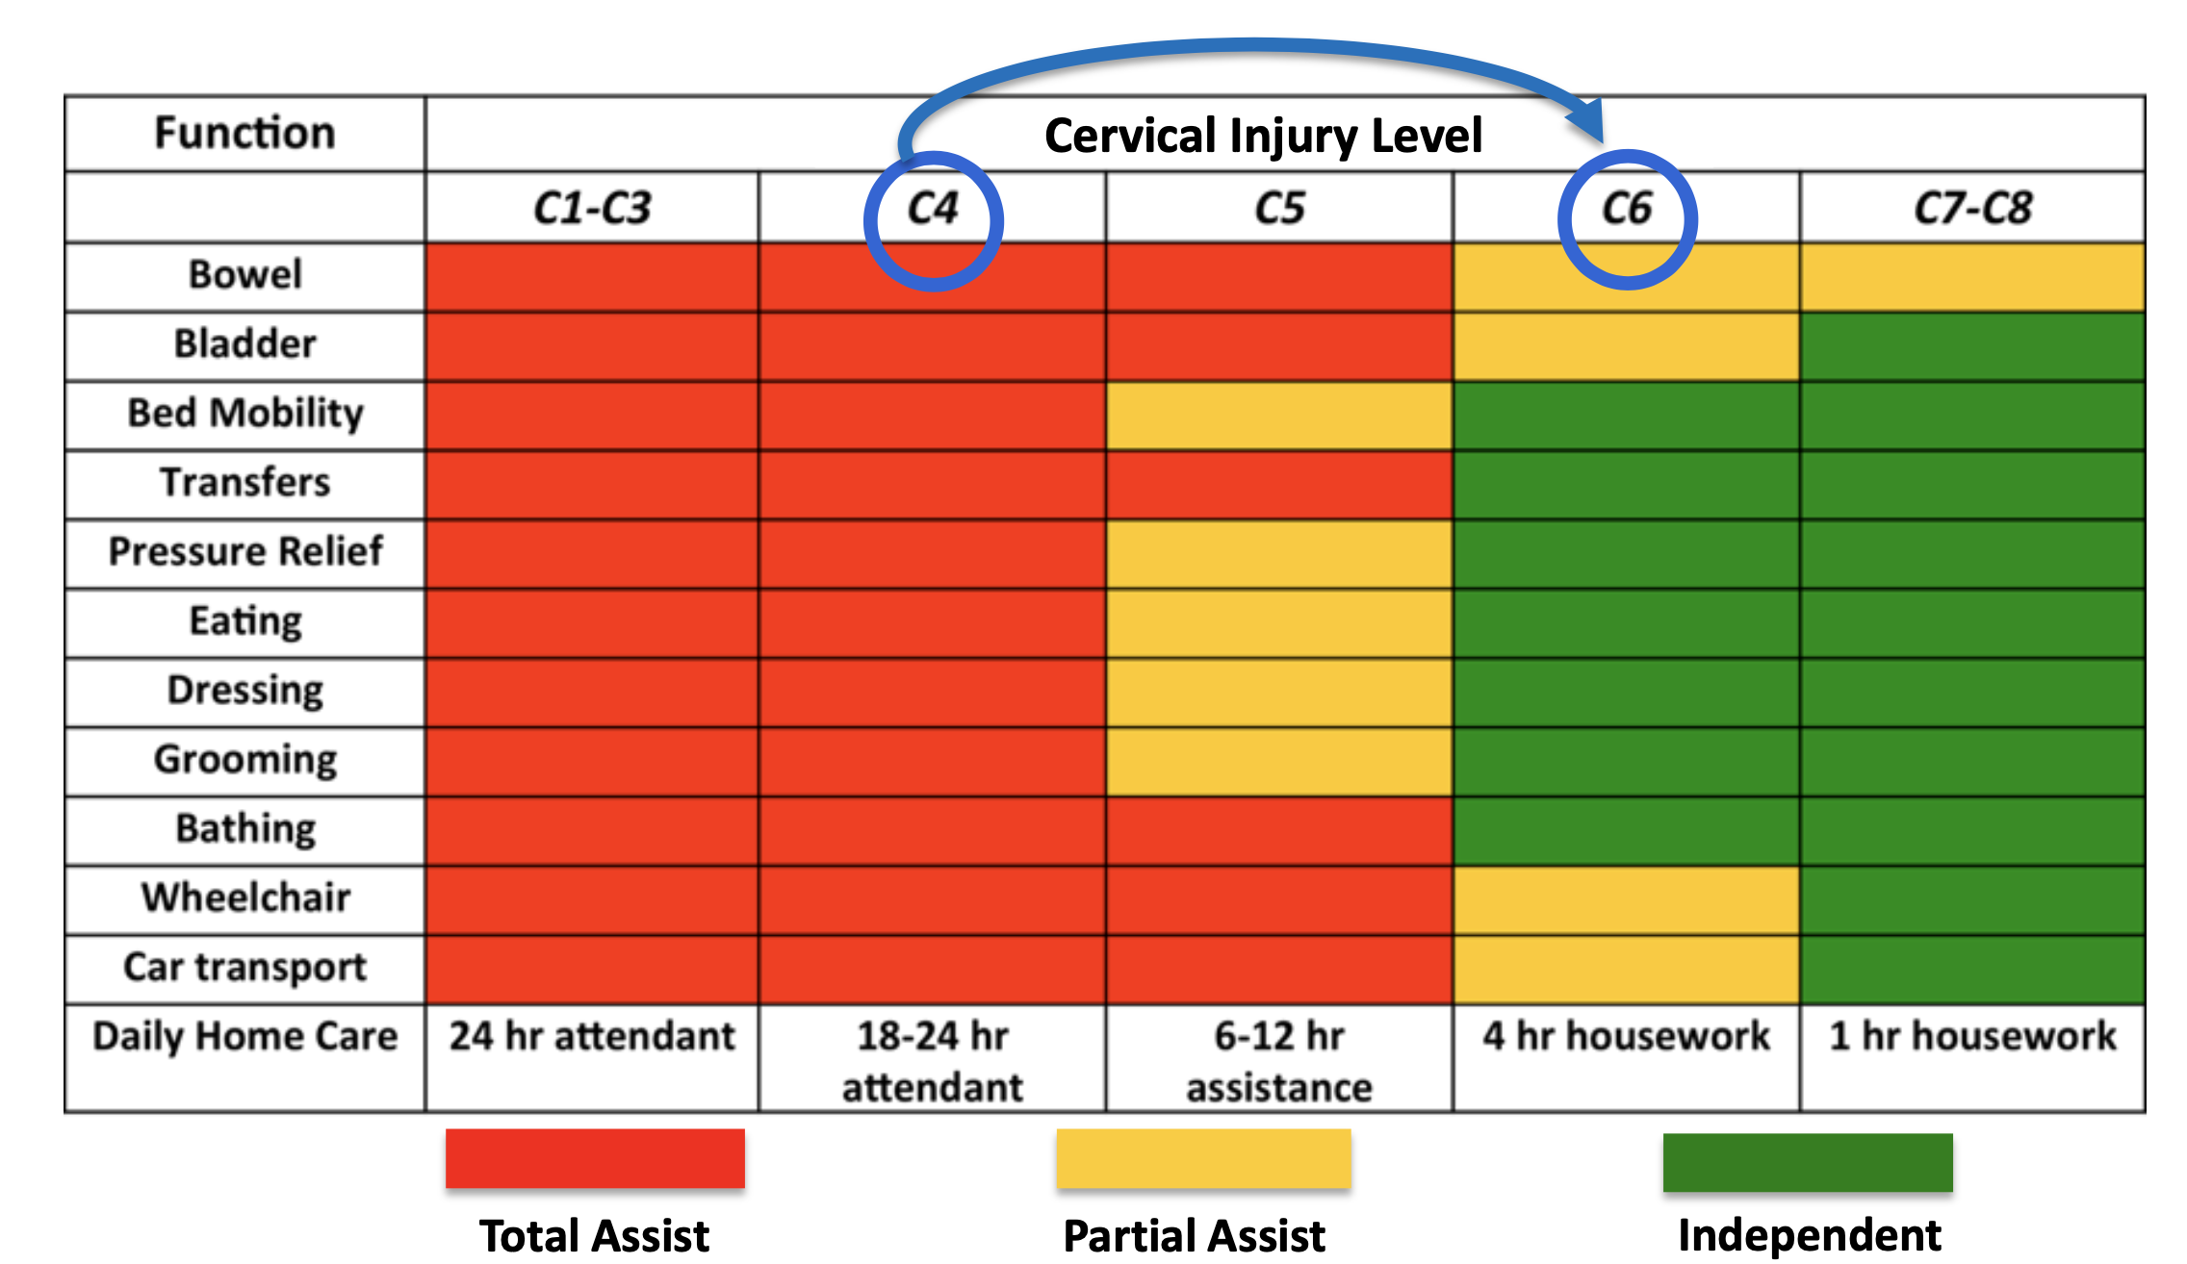
Benefits from a 2 Motor Level Improvement
32% of patients had
+2 Level Improvement

Slide 12
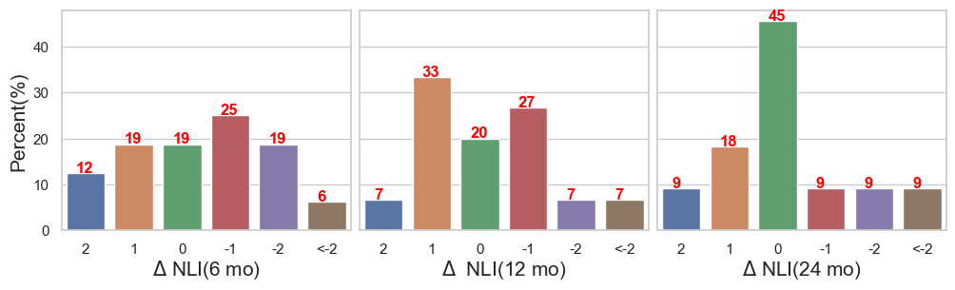
INSPIRE Clinical Trial Results
At 6 months, 12 months, most patients
had NLI score changes
within 1 or 2 levels in either direction
At 24 months majority patients
move back to no improvements

Slide 13
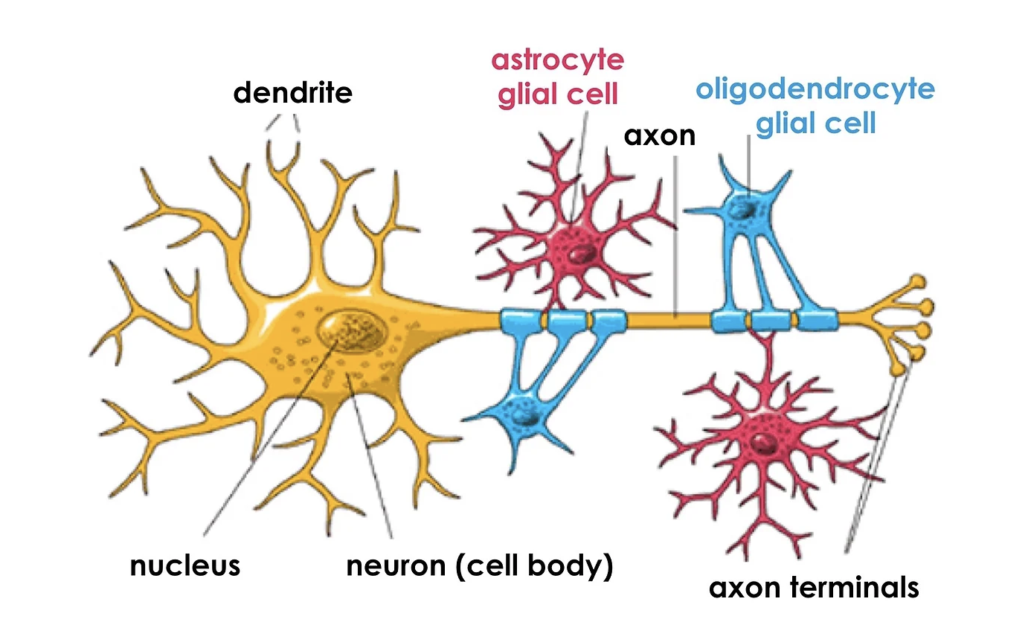
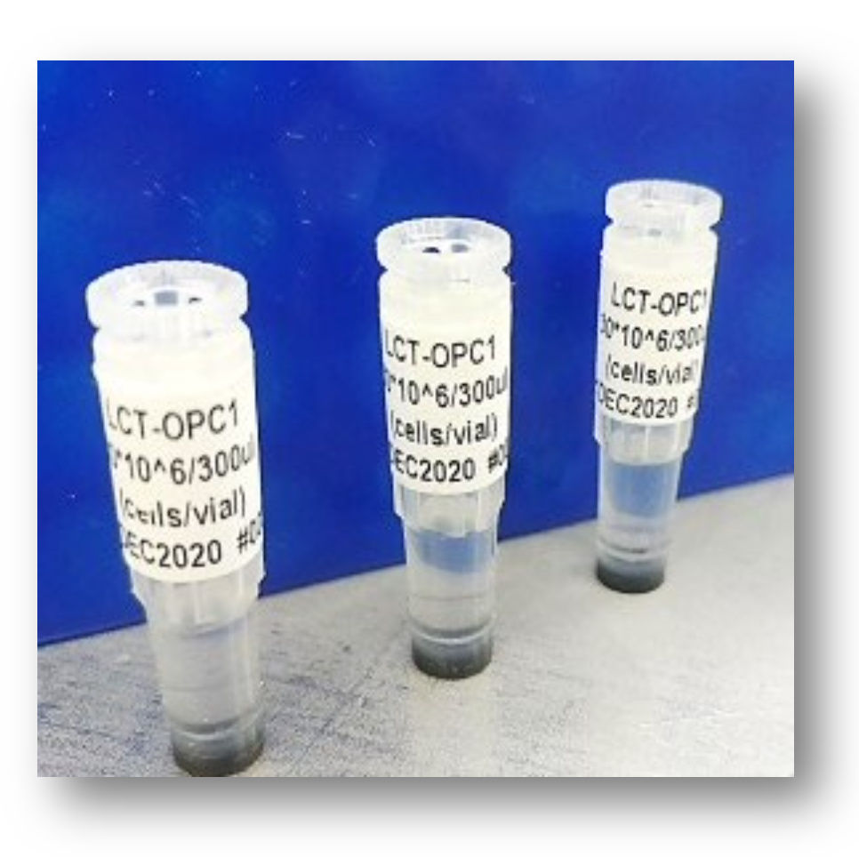
OPC1 cells for SCI
OPC1 is comprised of oligodendrocyte progenitor cells (OPCs) that are produced from NIH registered hESCs
OPCs differentiate into oligodendrocytes;
the myelinating cells of the CNS
The insulating role of myelin is essential for normal motor and sensory functions
OPC1 are allogeneic, not taken from the patients and injected at the injury site

Slide 14
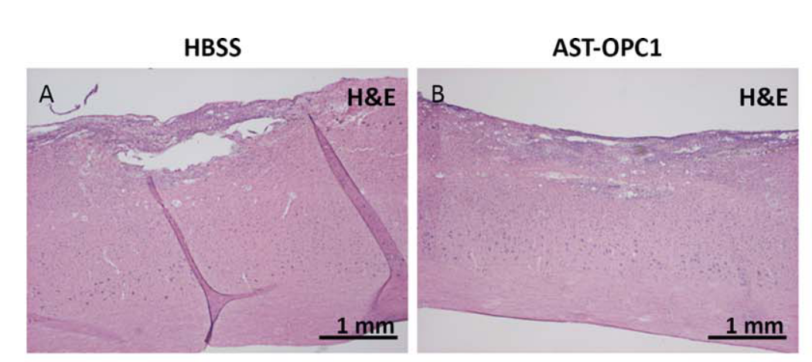
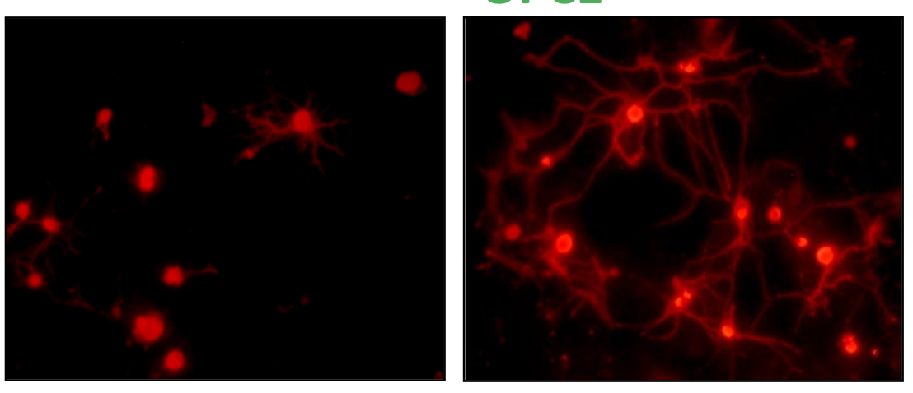
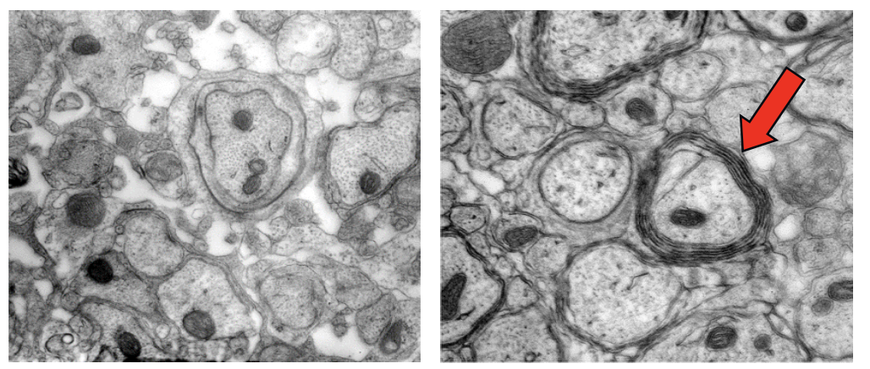
OPC1 Mechanisms of Actions
Suppression of cavitation
Myelination of Axons
Expression of neurotrophic factors
OPC1
OPC1

Slide 15

SCiStar Clinical Trial Design
Cohort 1
3 participants
Cohort 2
6 participants
Cohort 3
6 participants
AIS-A
severity
Cohort 4
6 participants
Cohort 5
4 participants
AIS-B
2M cells
10M cells
20M cells

Slide 16
SCiStar Top Line Data
96%
Successful
Engraftment
32%
Two or More
Levels
64%
One Level
22 Patients
at 12 months
No improvement (4%)
No improvement (4%)
Cell Engraftment
Motor Function Gain

Slide 17
INSIPIRE/SCiStar Clinical Trial Results
Patients exhibited motor recovery at 12 months
(at least 1 motor level)
No unexpected adverse events
No serious adverse events related to products
No patients had worsening neurological function

Slide 18

Conclusion
SCI is complex, multifactorial and multiphasic
The dogma that SCI was irreversible and untreatable and nerves in the CNS could not regrow finally, can be put to rest due to research in:
- Neuroprotection
- Axon growth and remyelination
- Growth inhibition (glial scar)
- Axon guidance, and synapse formation
Neural-Spinal scaffold and OPC1 are promising therapies, combining them may boost the success of finding a cure for SCI
SCI treatments require a huge investment in money and time which may slow down research
TE already made significant contributions and will continue to play a major role

Slide 19


Slide 20
Extra slides

Slide 21
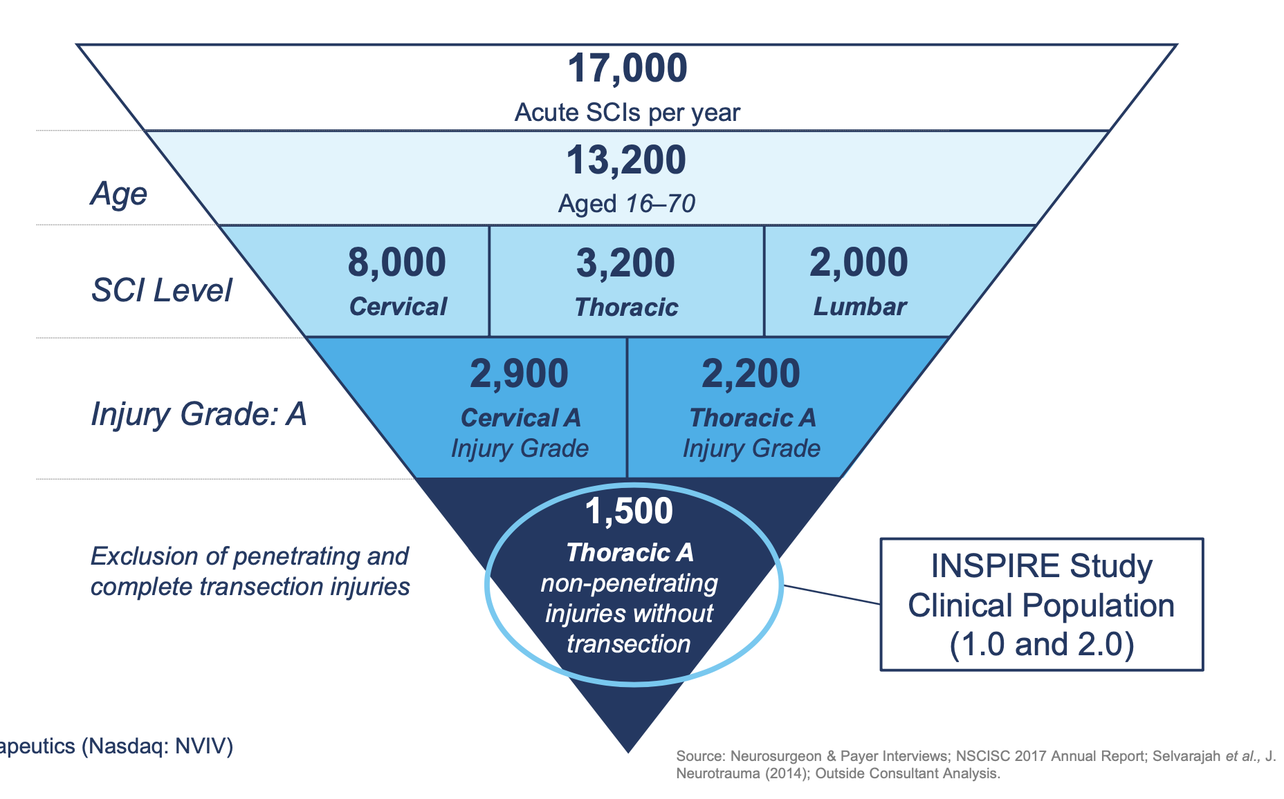
INSPIRE Clinical Trial Cohort Characteristics
Source: Kim, Kee D., et al. “Acute Implantation of a Bioresorbable Polymer Scaffold in Patients With Complete Thoracic Spinal Cord Injury: 24-Month Follow-up From the INSPIRE Study.”

